Slide 1

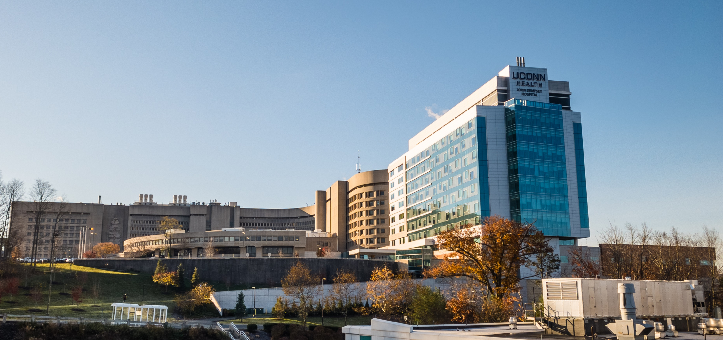

Financial Update
for UConn & UConn Health
Briefing for the Financial Affairs Committee of the Board of Trustees
February 2023

Slide 2
UConn: FY23 Budget
Through the second quarter, the University is projecting a balanced budget in FY23

Slide 3
UConn: FY23 Financial Improvement Plan
Through the second quarter of FY23, the University has realized $14.7M in savings of a $19.7M total updated FIP target and is on track to end the year with a balanced budget.

Slide 4
UCH: FY23 Budget
UConn Health is projecting a balanced budget in FY23

Slide 5
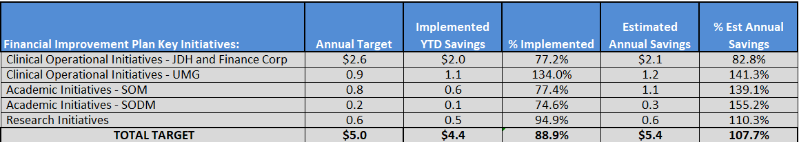
UCH: FY23 Financial Improvement Plan
Through the second quarter of FY23, UConn Health has realized $4.4M in savings and is on track to exceed the full $5.0M target

Slide 6

UConn & UConn Health Request vs. Governor Proposal
 | University Request |  | Governor Proposal
 | FY24 | FY25 | FY24 | FY25
Base | $341.9 | $341.9 | $281.7 | $281.7
Block CBI | 46.8 | 50.6 | 43.2 | 49.0
Non-Block CBI | 114.6 | 114.6 | 73.6* | 36.8*
Legacy | 108.7 | 113.2
Other | 3.2 | 3.2
Total Operating | $615.2 | $623.5 | $398.6 | $367.5
Total w/Fringe | $1,002.3 | $1,018.2 | $842.7 | $821.1
Shortfall (including in-kind Fringe) |  |  | $159.6 | $197.1
$159.6
$197.1
CBI=Collective Bargaining Increase
*Governor’s proposal utilizes one-time ARPA funding

Slide 7
UConn & UConn Health
FY23 – FY25: Actual/Request/Proposed

